Slide 1




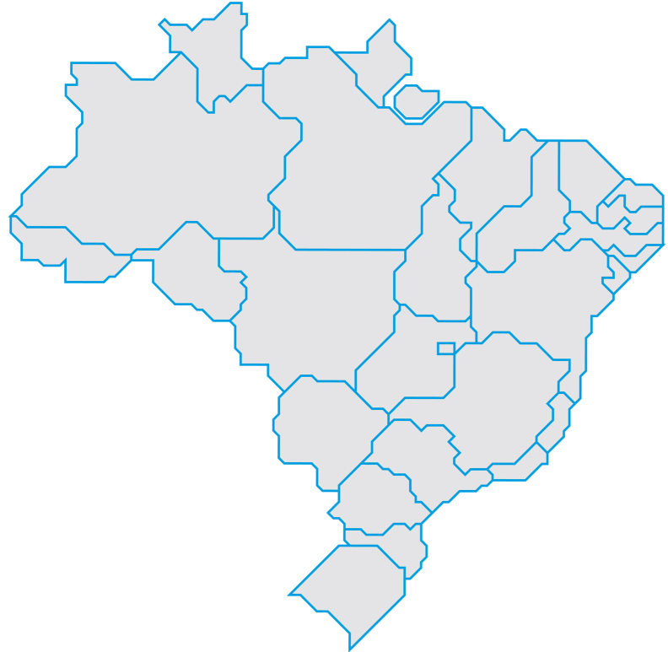
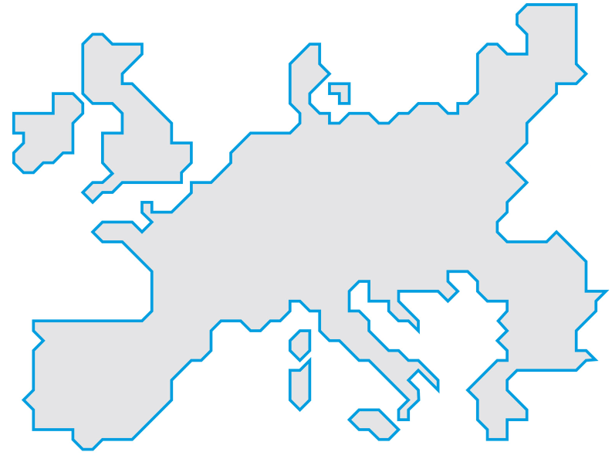






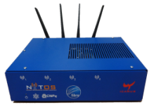


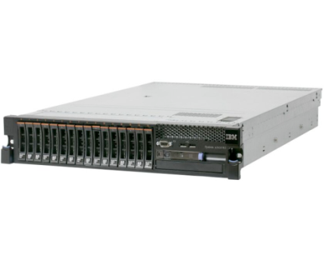

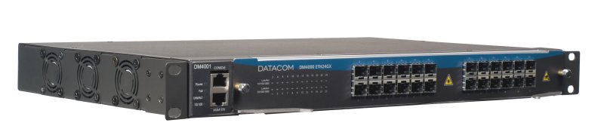







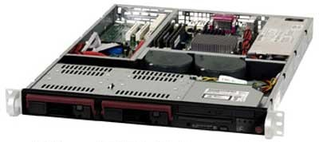




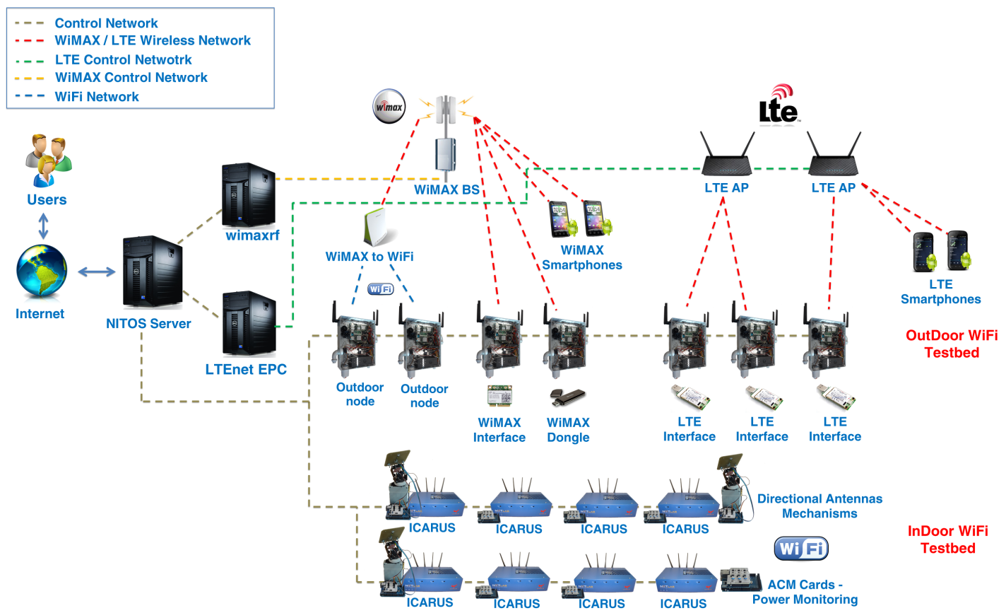
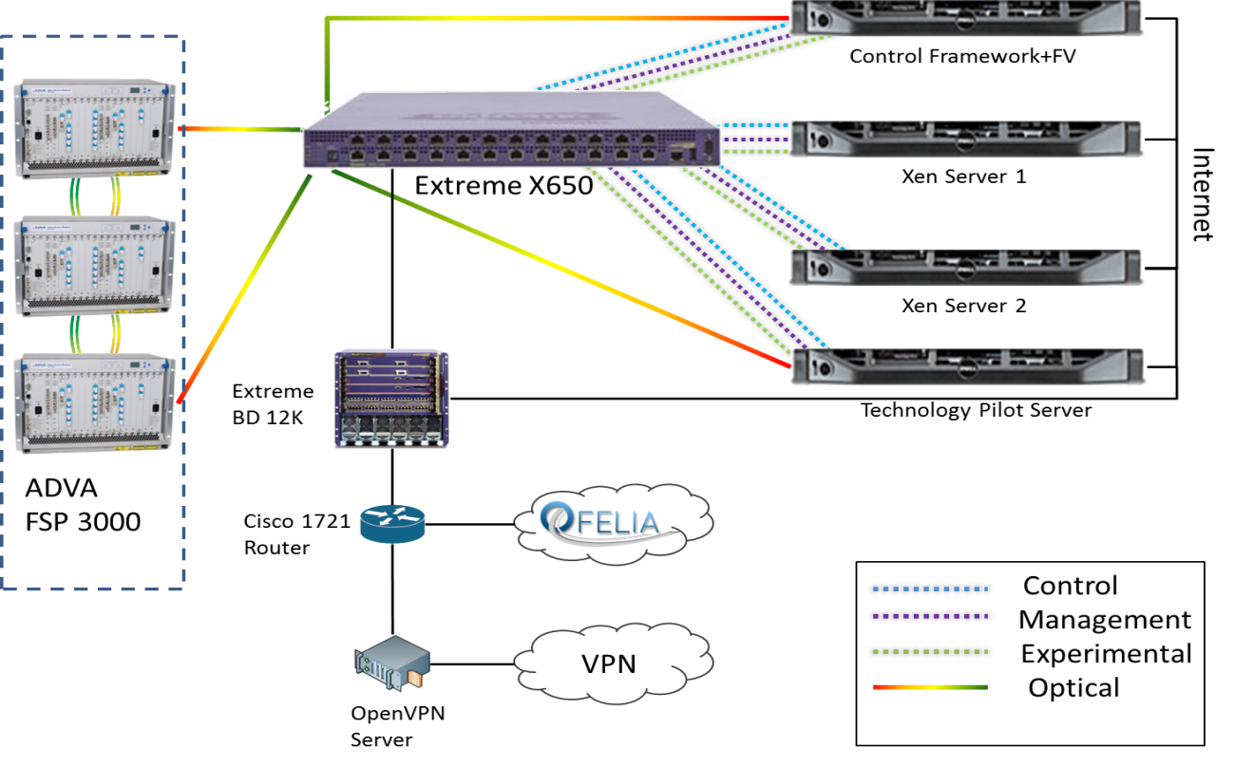
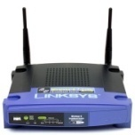
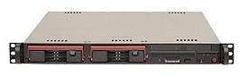



facebook.com/fibre.project
@FIBRE_project
www.fibre-ict.eu
FIBRE - Intercontinental Testbed for Future Internet Experimentation
Sebastia Sallent¹, Antonio Abelém², Iara Machado³, Leonardo Bergesio¹, Serge Fdida⁴, José Rezende⁵, Dimitra Simeonidou⁶, Marcos Salvador⁷, Leandro Ciuffo³, Leandros Tassiulas⁸ and Carlos Bermudo¹
¹ {sebastia.sallent, leonardo.bergesio, carlos.bermudo}@i2cat.net | ² abelem@ufpa.br | ³ {iara, leandro.ciuffo}@rnp.br | ⁴ serge.fdida@lip6.fr | ⁵ rezende@land.ufrj.br | ⁶ dsimeo@essex.ac.uk | ⁷ marcosrs@cpqd.com.br | ⁸ leandros@uth.br
EXPERIMENTAL ISLANDS
CONTROL FRAMEWORKS
With the globalization of experimental FI research, there has been considerable interest in the federation of distinct testbed facilities, in order to permit carrying out experiments that span multiple testbeds. Federation is a key issue in the design of the FIBRE testbed, which is being deployed as a federation of 13 local experimental facilities (a.k.a. “islands”).
OFELIA Control Framework (OCF) was originally created in the context of the OFELIA testbed project [www.fp7-ofelia.eu] but today it is supported by a larger community where FIBRE and GEANT are present. OCF is synchronized with other initiatives in USA (GENI) and follows an SFA-oriented architecture (Slice-based Facility Architecture).
OMF is a framework with the focus on controlling and managing network devices. It was developed based on XMPP in the Ruby language. The OMF suite also provides OML (OMF Monitoring Library), which allows instrumentation of applications for collecting measurements.
ProtoGENI is a control and monitoring based on an enhanced version of the Emulab management software. The Emulab testbed is used to perform experimental research on distributed systems. ProtoGENI was created to provide the integration between Emulab and other testbeds in order to build the Cluster C facility of GENI.
UFPA
U.Bristol
UNIFACS
UFPE
I2CAT
UTH
UFPA
UFPE
U. Bristol
RNP
UNIFACS
OMF
UFSCar
WDM
BRAZIL
UFG
EUROPE
OMF
OCF
OMF
OCF
OCF
OCF
OMF
UFSCar
CPqD
UFF
UFRJ
UFG
PoP-BA
PoP-PA
PoP-PE
OCF
PoP-UB
USP
Situation as of May 2013
OCF
OMF
PoP-GO
PoP-SP
Proto
GENI
PoP-i2CAT
PoP-UTH
OCF
PoP-DF
PoP-RJ
OCF
OMF
RNP
WDM
USP
OCF
OMF
A TYPICAL BRAZILIAN ISLAND
OCF
OMF
OCF
OMF
OCF
OMF
i2CAT
UTH
UFRJ
UFF
CPqD
Wireless experimental facility
OFELIA Control Framework
OMF
ProtoGENI
Icarus node #8
WDM GMPLS
. . .
Wireless Network
(OMF domain)
NETWORK LIGHTPATHS
Icarus node #1
The physical interconnection of Brazilian and European islands is deployed through two point-to-point circuits (a.k.a. lightpaths) linking FIBRE´s Brazilian gateway at the University of Sao Paulo (USP, Brazil) to i2CAT (Spain) and University of Bristol (UK), spanning multiple network domains.
Pica8 Pronto Switch
IBM server
(VMs, LDAP)
Top of Rack
conventional
switch
Datacom OpenFlow switch
(FIBREnet border router)
Red IRIS
NetFPGA #1
Control plane link
NetFPGA #2
NetFPGA #3
Data plane link
Data + Control plane
AMPATH
EUROPEAN ISLANDS
To UnivBRIS and NITOS
To RedIris and RNP (Brazil)
ROADM
DWDM ring
Barcelona
ROADM
To OFELIA island (i2CAT)
ROADM
1GbE
SuperMicro 6016T-T Servers
1GbE
100MbE
Pronto TN3290
Switches
Linksys WRT54GL
Wi-Fi routers
i2CAT
Bristol
i2CAT (Spain)
UTH (Greece)
U. Bristol (UK)
This work makes use of results produced by the FIBRE project, co-funded by the Brazilian Council for Scientific
and Technological Development (CNPq) and by the European Commission within its Seventh Framework Programme.

